Slide 1
Load data in bw from flat file
Milind Parab

Slide 2
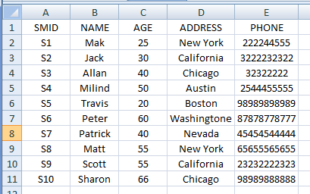
Data In Flat File.

Slide 3
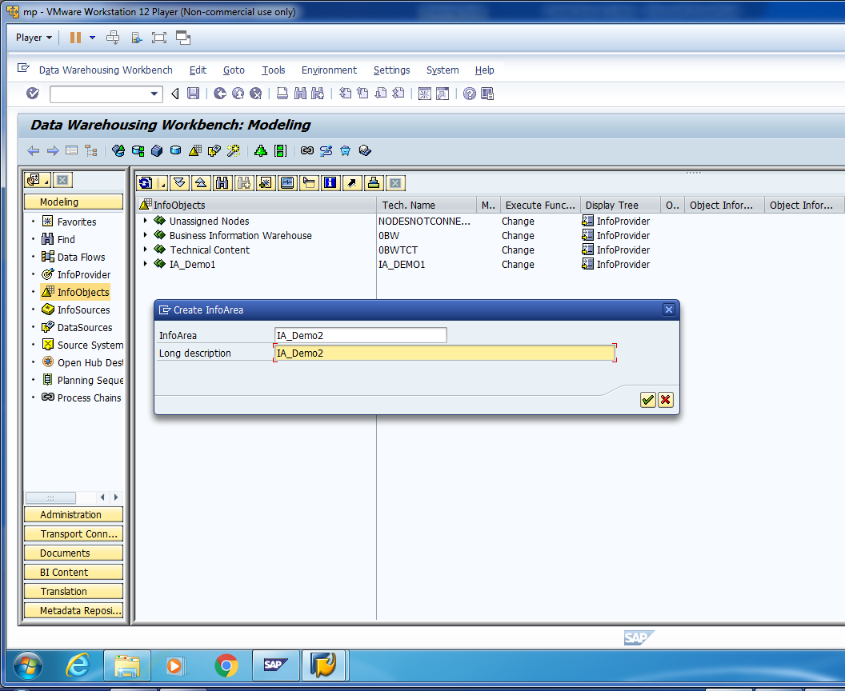
Create Info-Area for Demo-2.

Slide 4
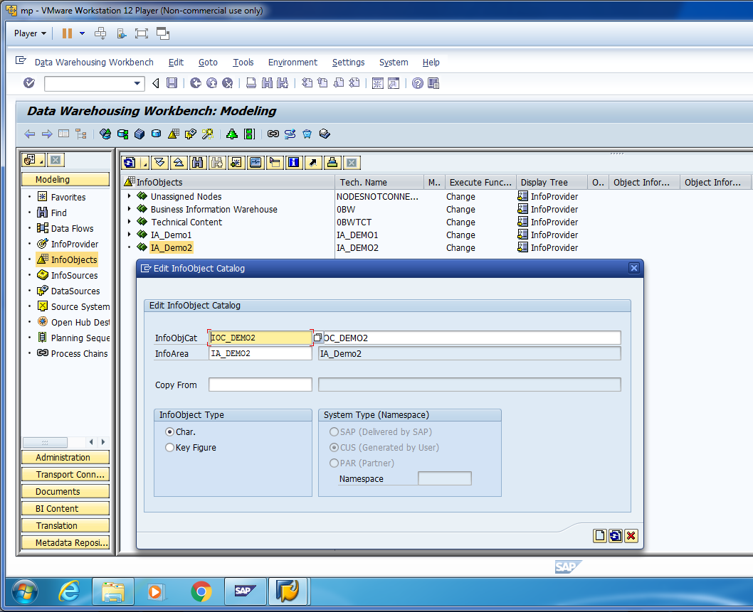
Create Info-Object Catalog for Demo-2.

Slide 5
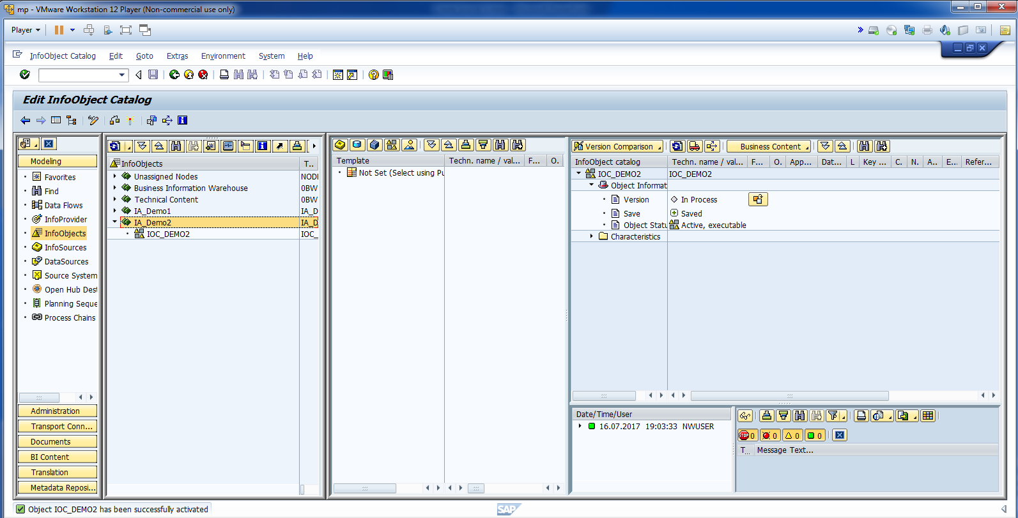
Activate Info-Object Catalog.

Slide 6
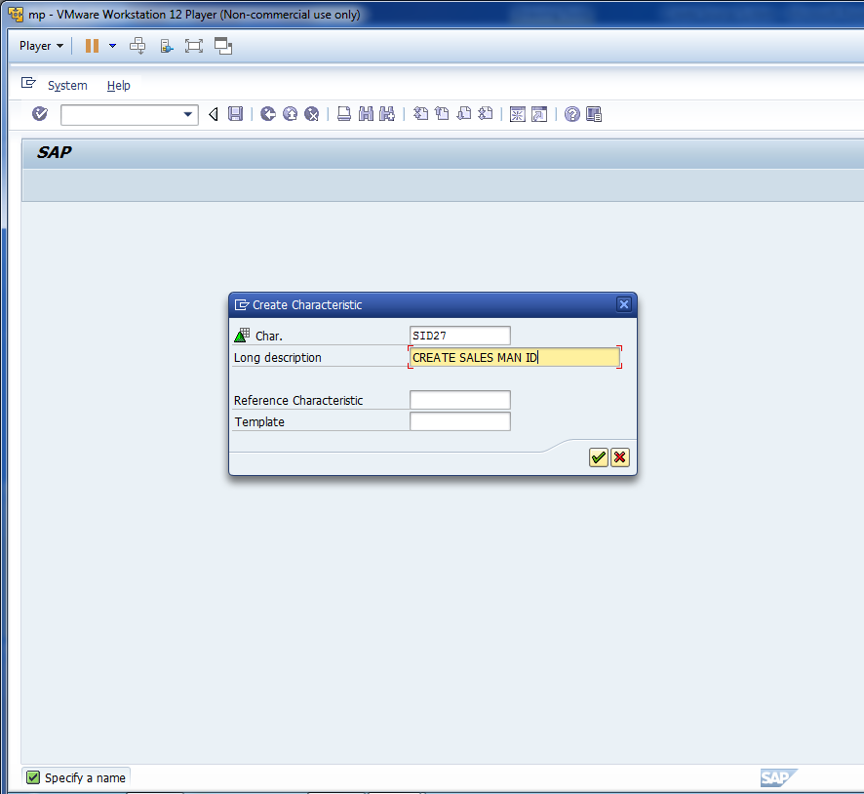
Create Info-Object.

Slide 7
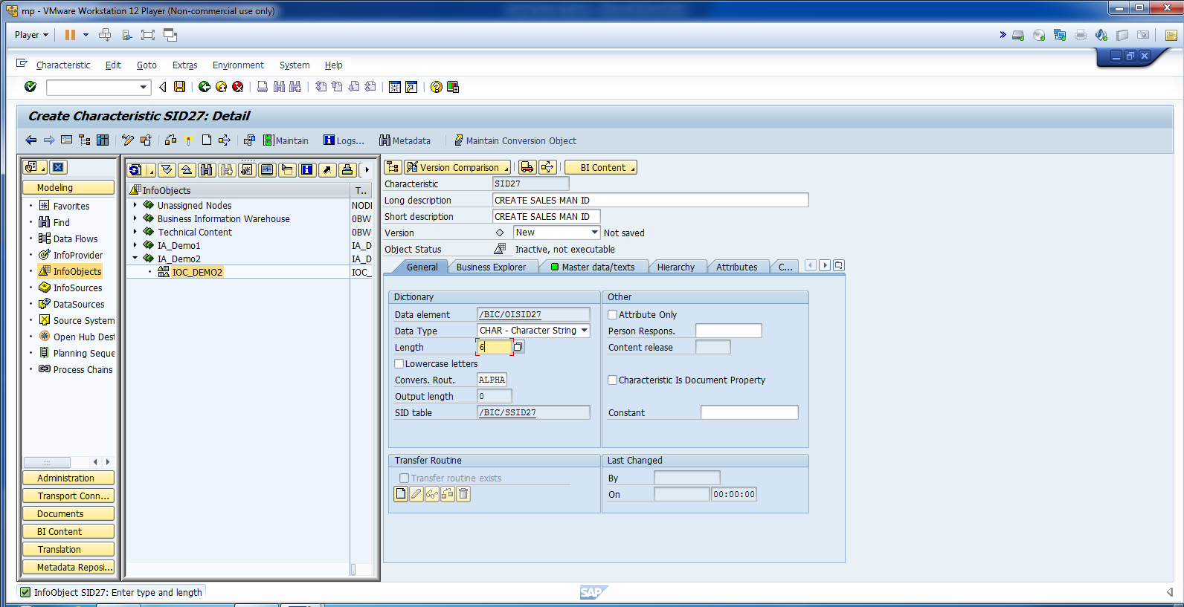
Update Information for SID27.

Slide 8
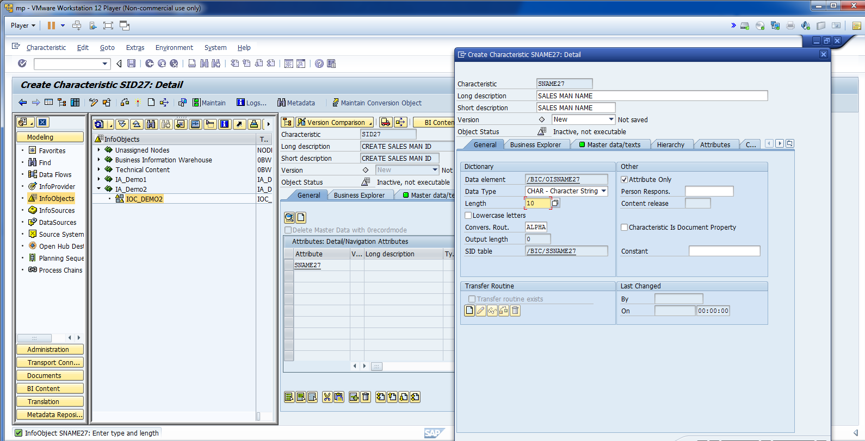
Now, create Name, Age, Address, and Phone Number Attributes.

Slide 9
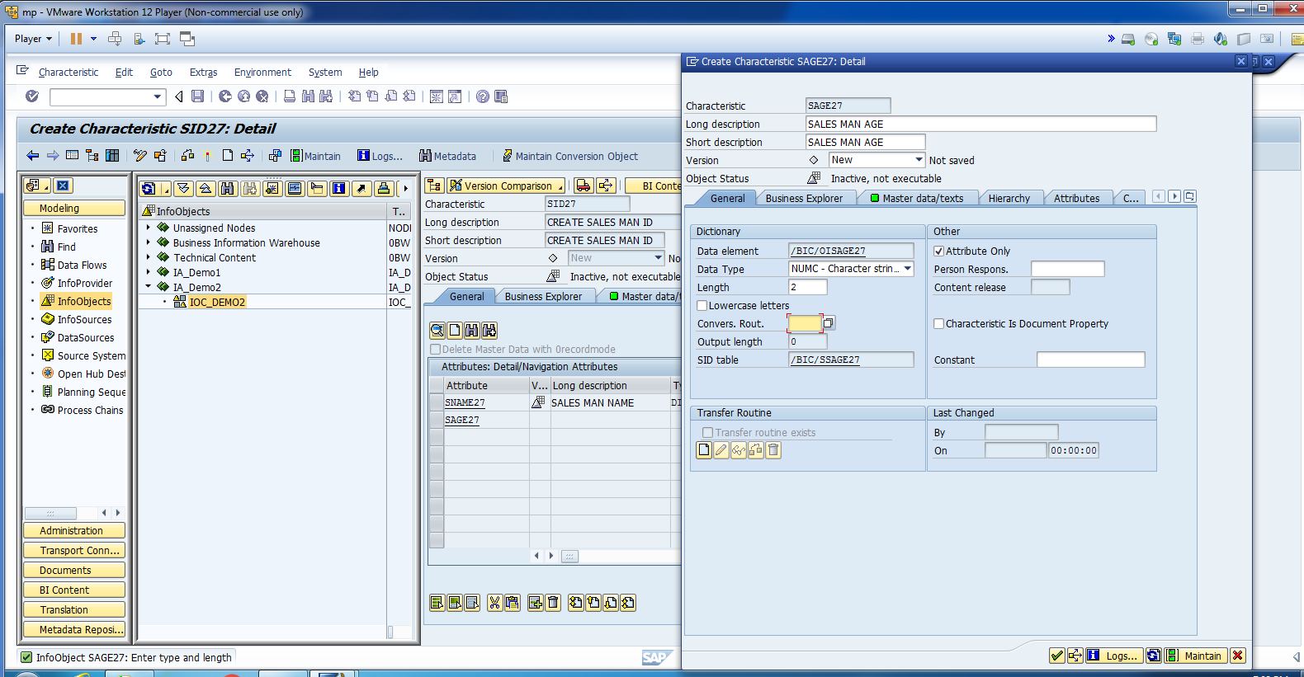
Age Attribute.

Slide 10
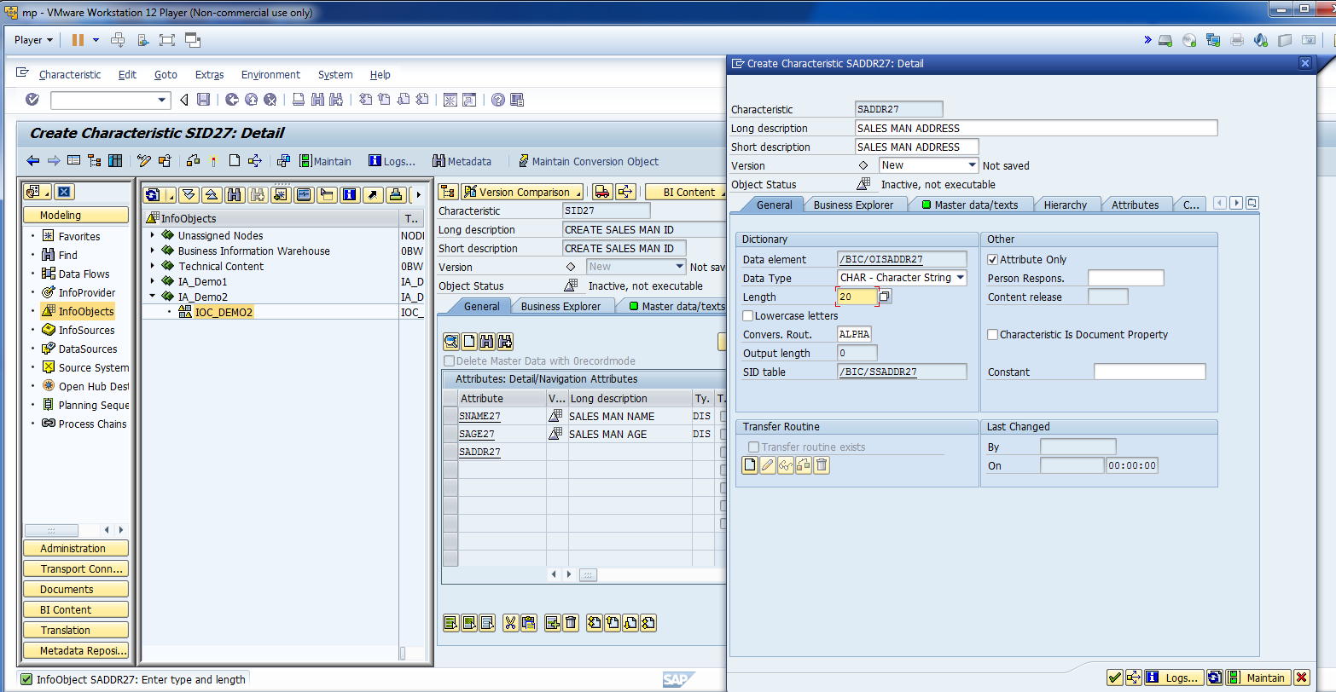
Address Attribute.

Slide 11
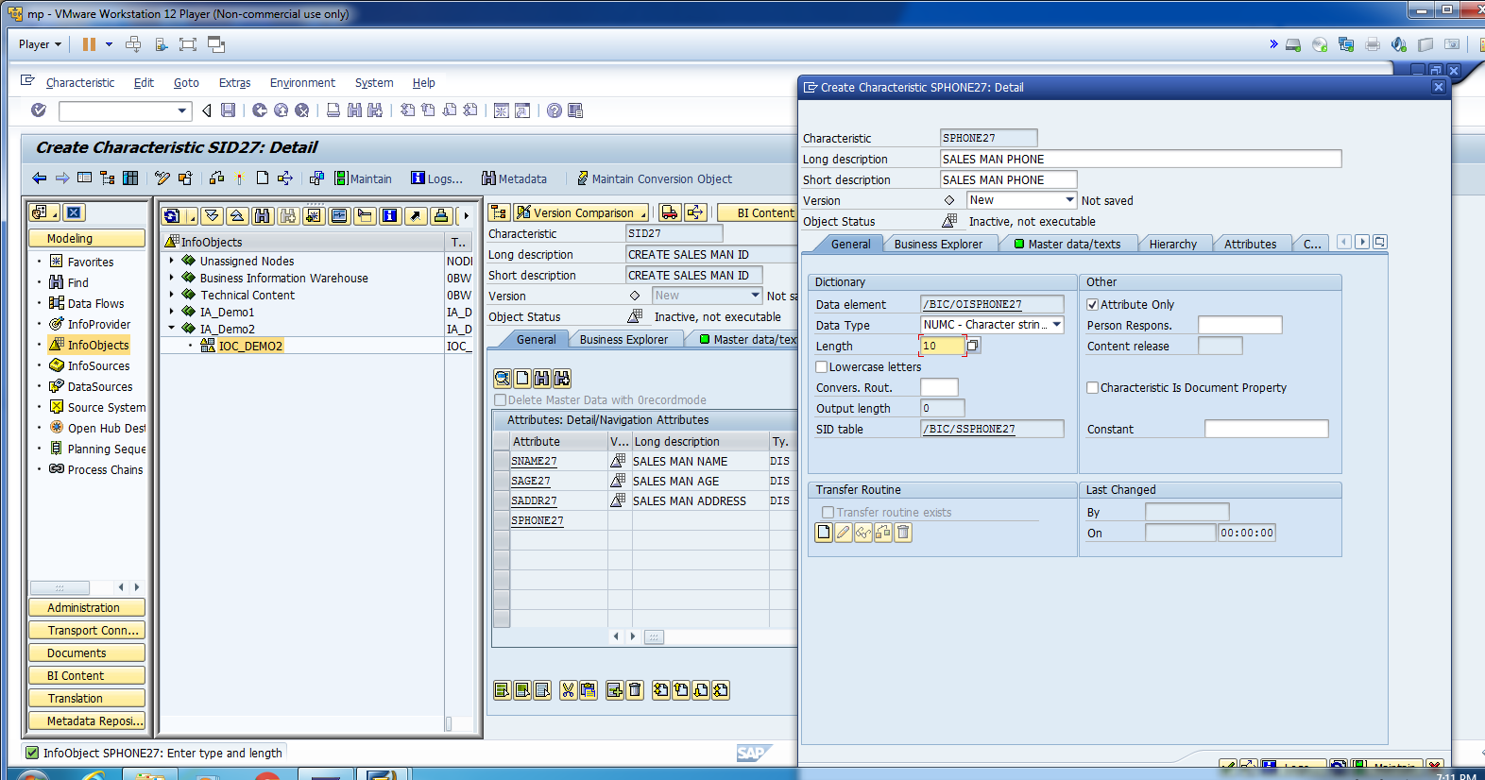
Phone Attribute.

Slide 12
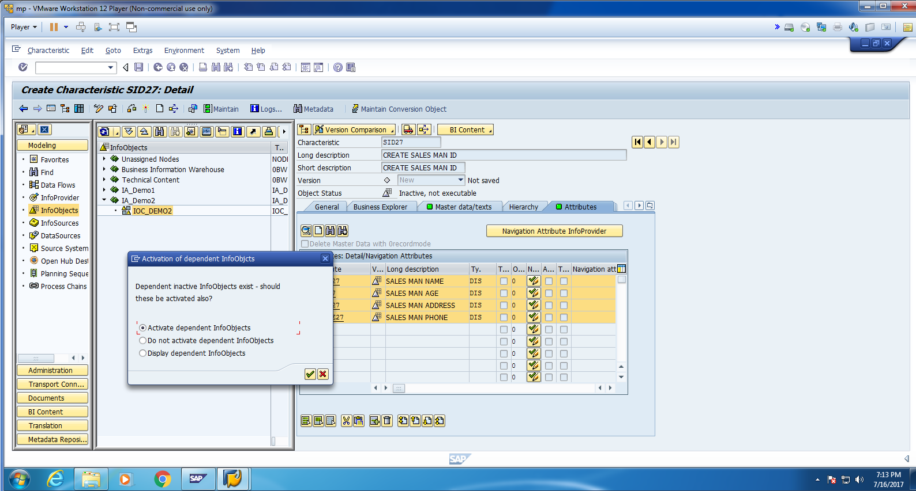
Activate Info Objects.

Slide 13
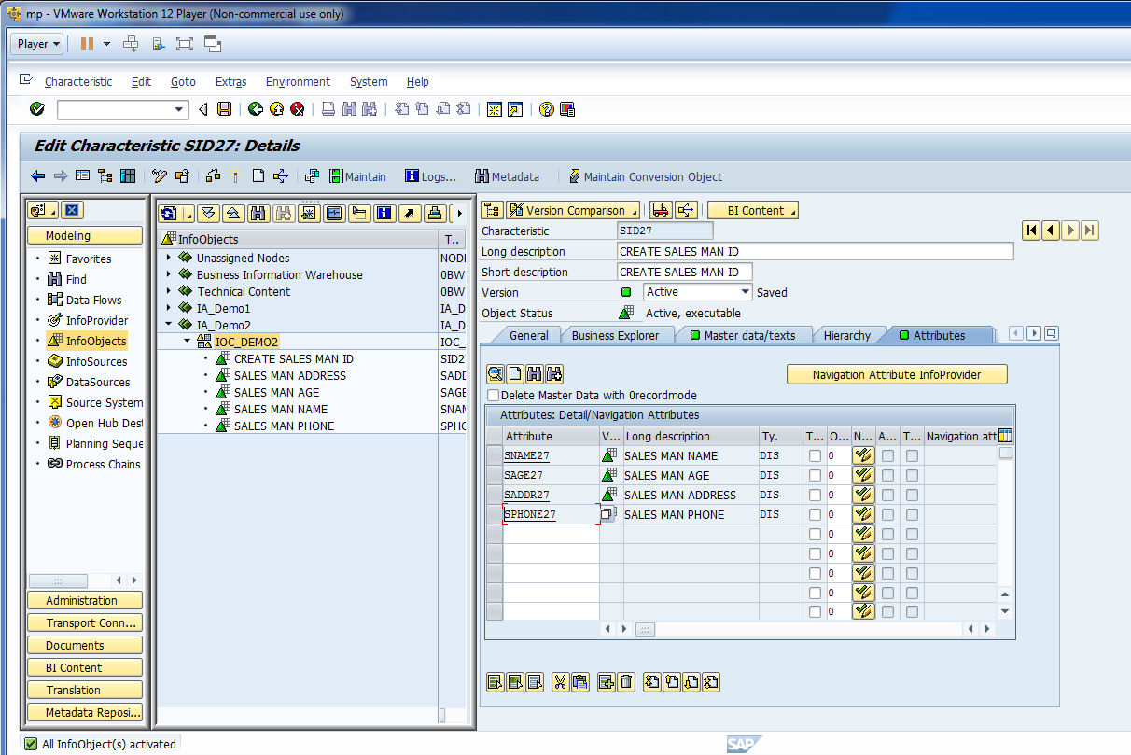
You can see below, all objects are activated.

Slide 14
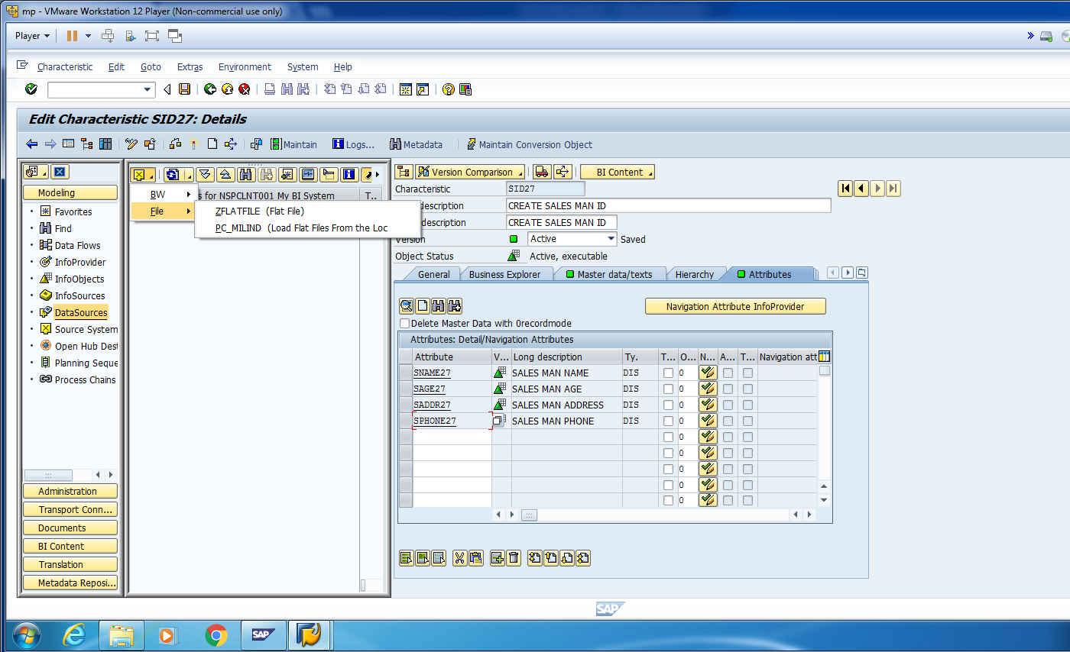
Now Click on File and Make sure that correct data source is selected. Eg. PC_MILIND in this example.

Slide 15
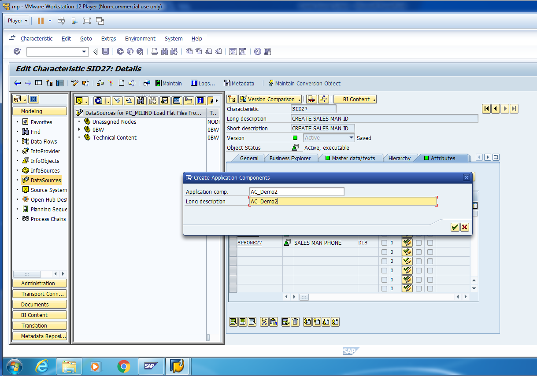
Create Application Component by Right Click on Data-Source Status Bar.

Slide 16
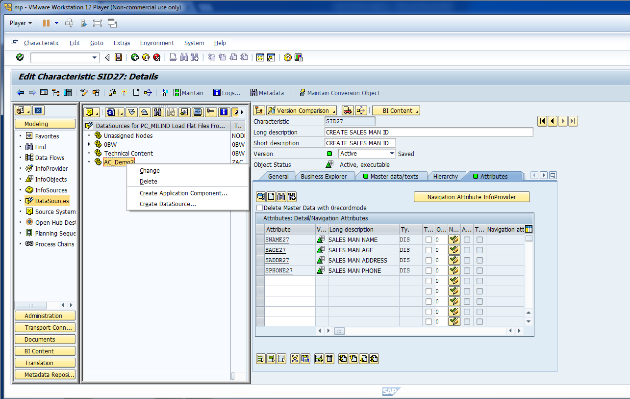
Now, create a Data Source.

Slide 17
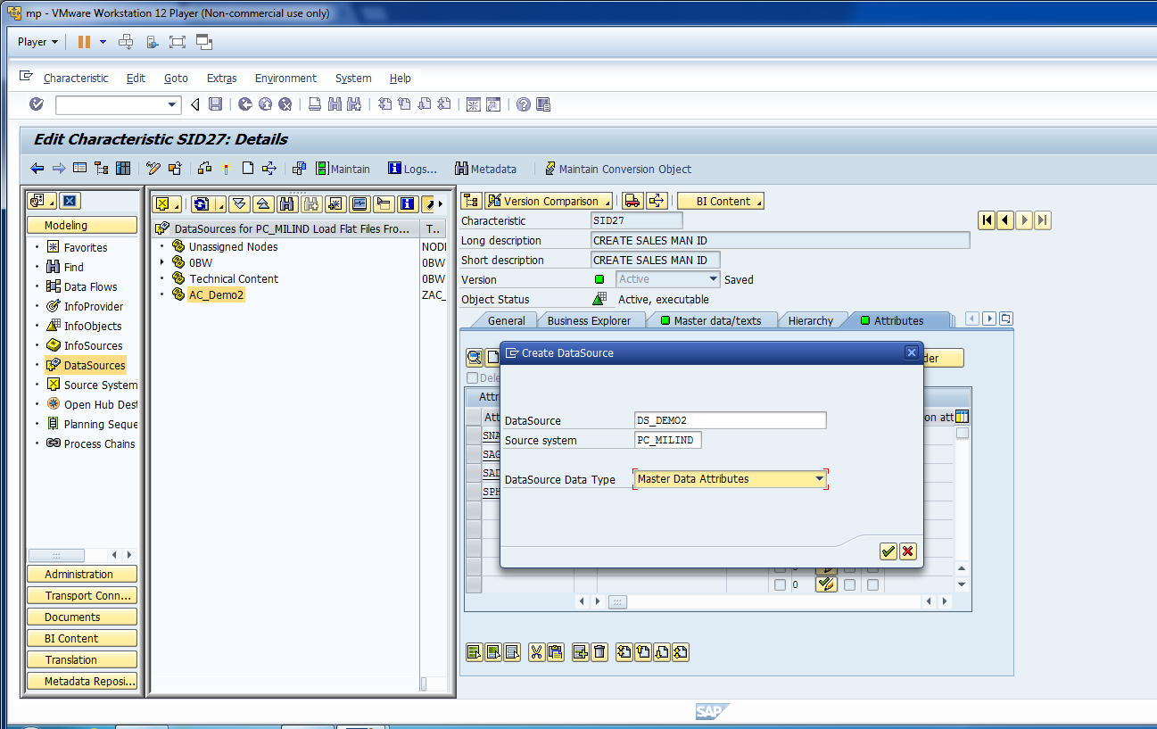
Cont.

Slide 18
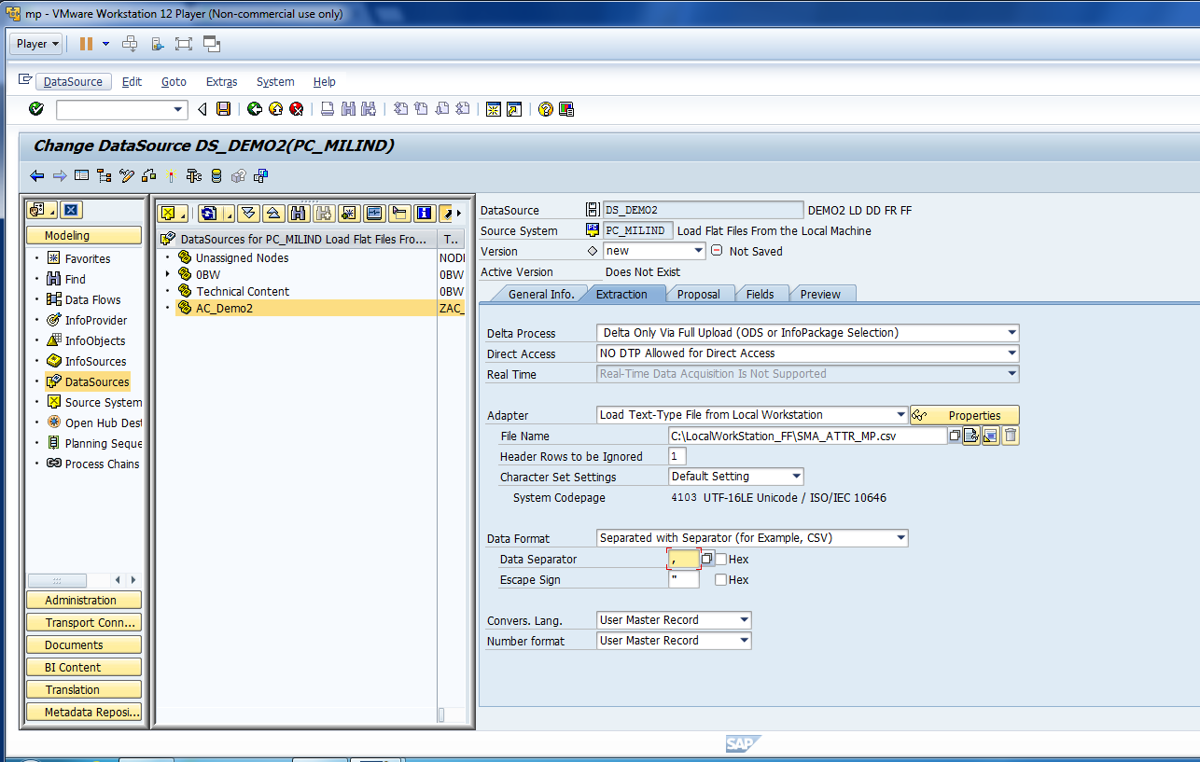
Update Extraction Information.

Slide 19
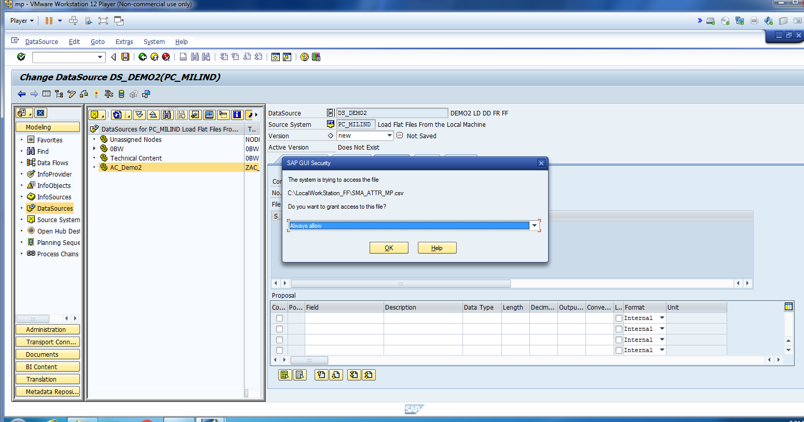
Allow BW to Access The Location.

Slide 20
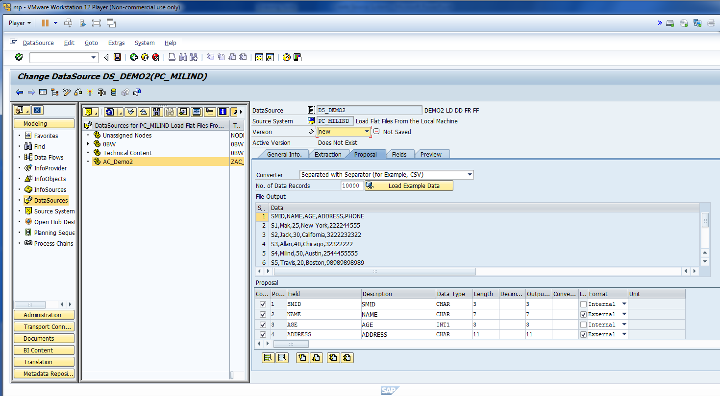
Check The Proposal Data.

Slide 21
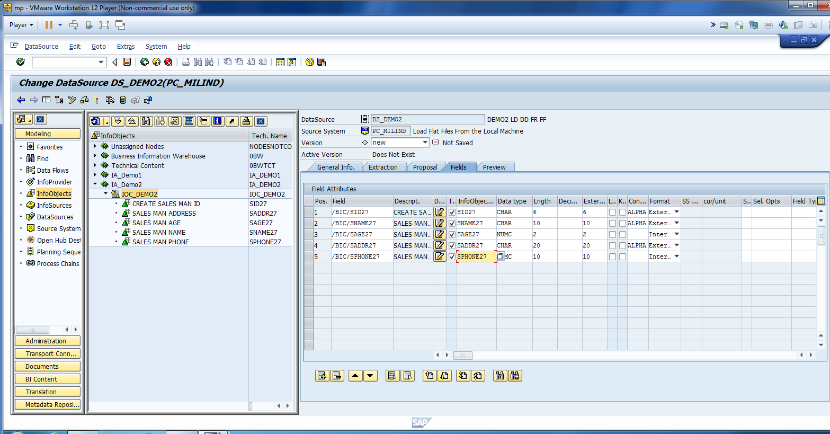
Map Excel Fields with Info Objects.

Slide 22
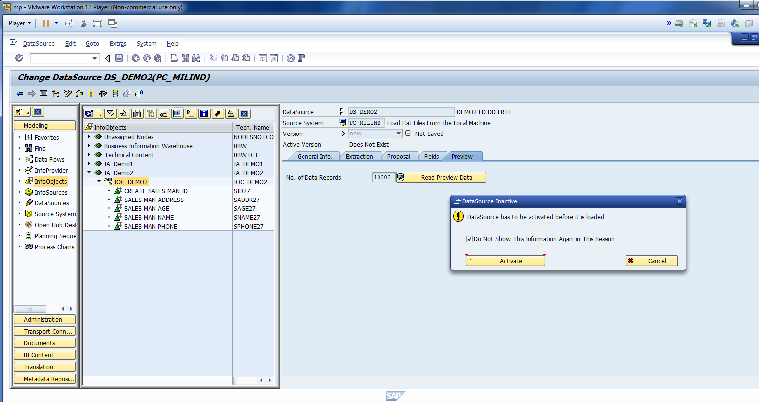
Activate Data Source to See Preview Data.

Slide 23
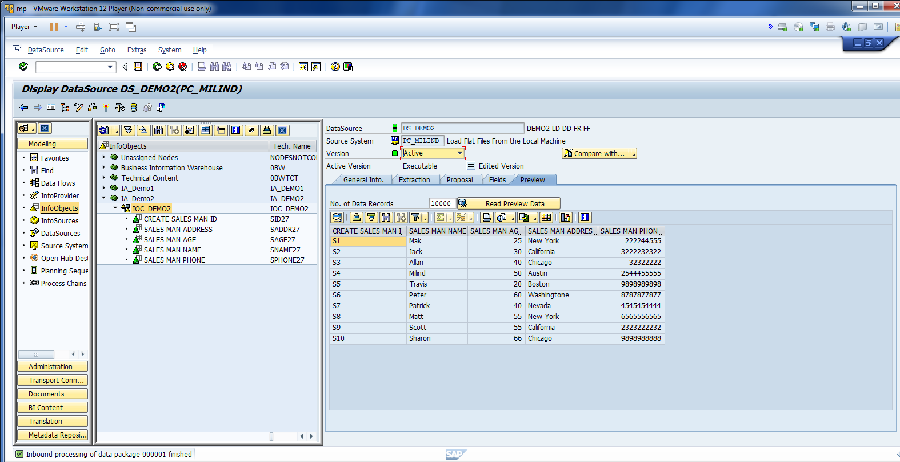
You should see load preview.

Slide 24
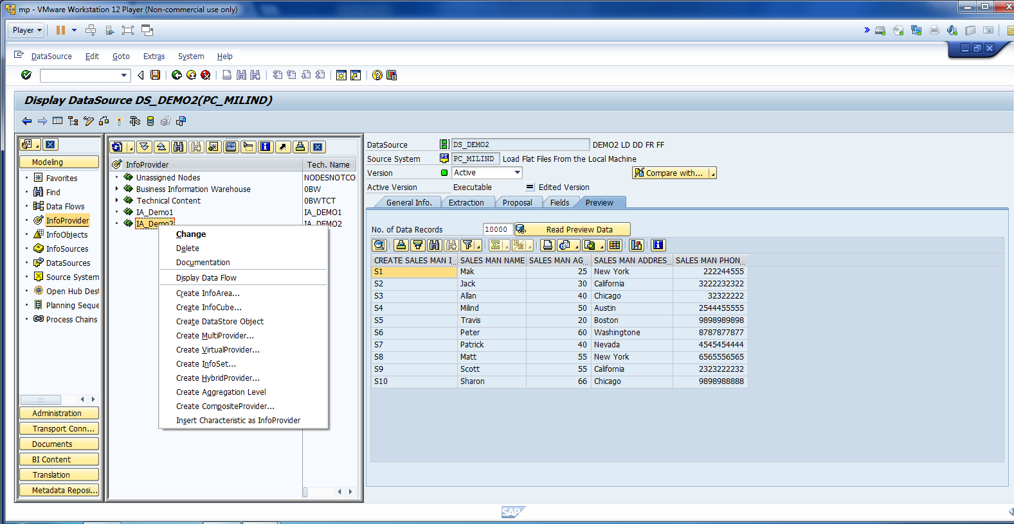
Create Data Target. Select Insert Char. as Info-Provider.

Slide 25
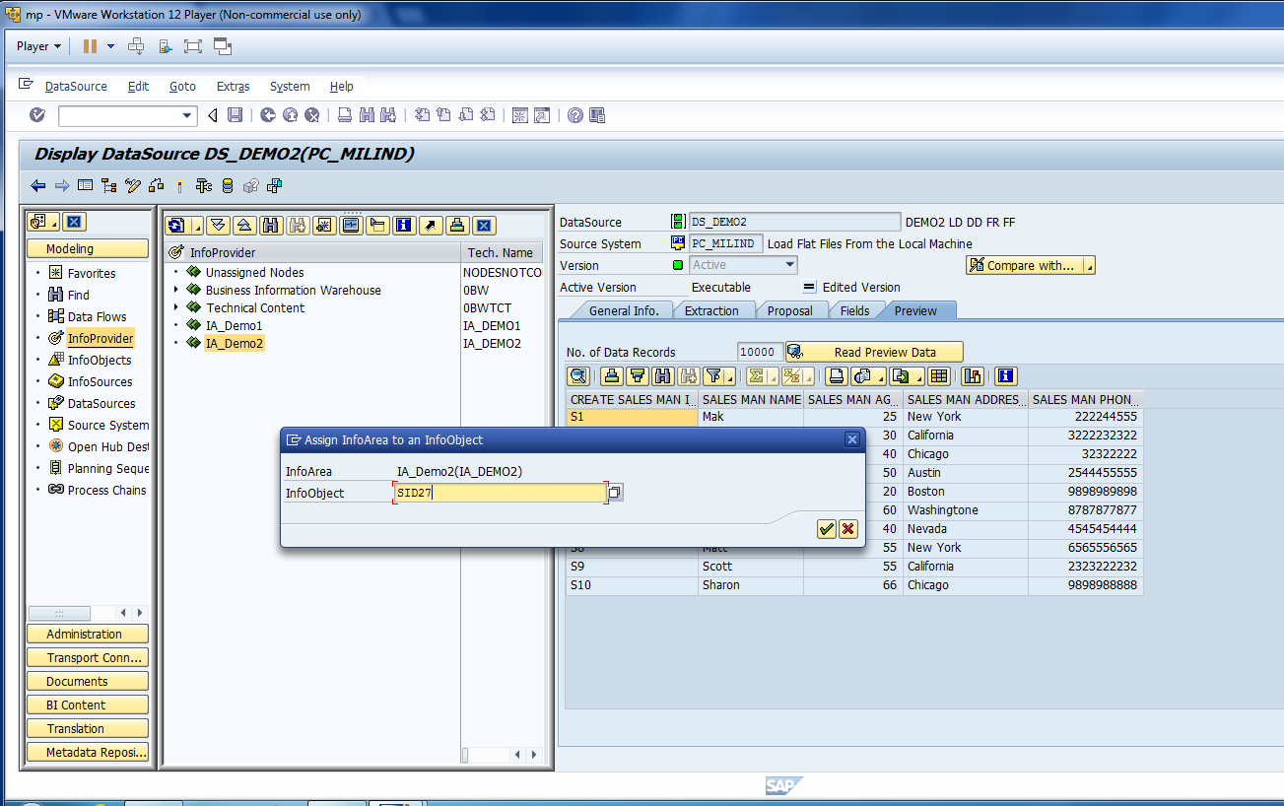
Enter Info Object Tech Name.

Slide 26
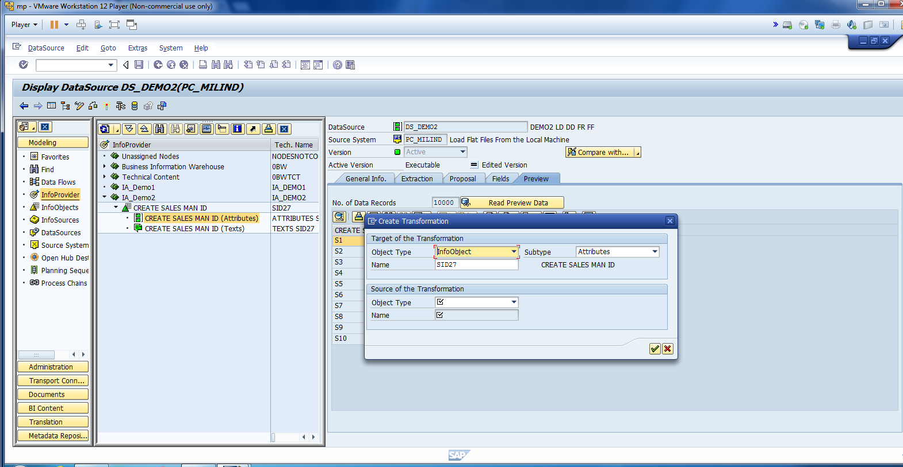
Now, Create Transformation.

Slide 27
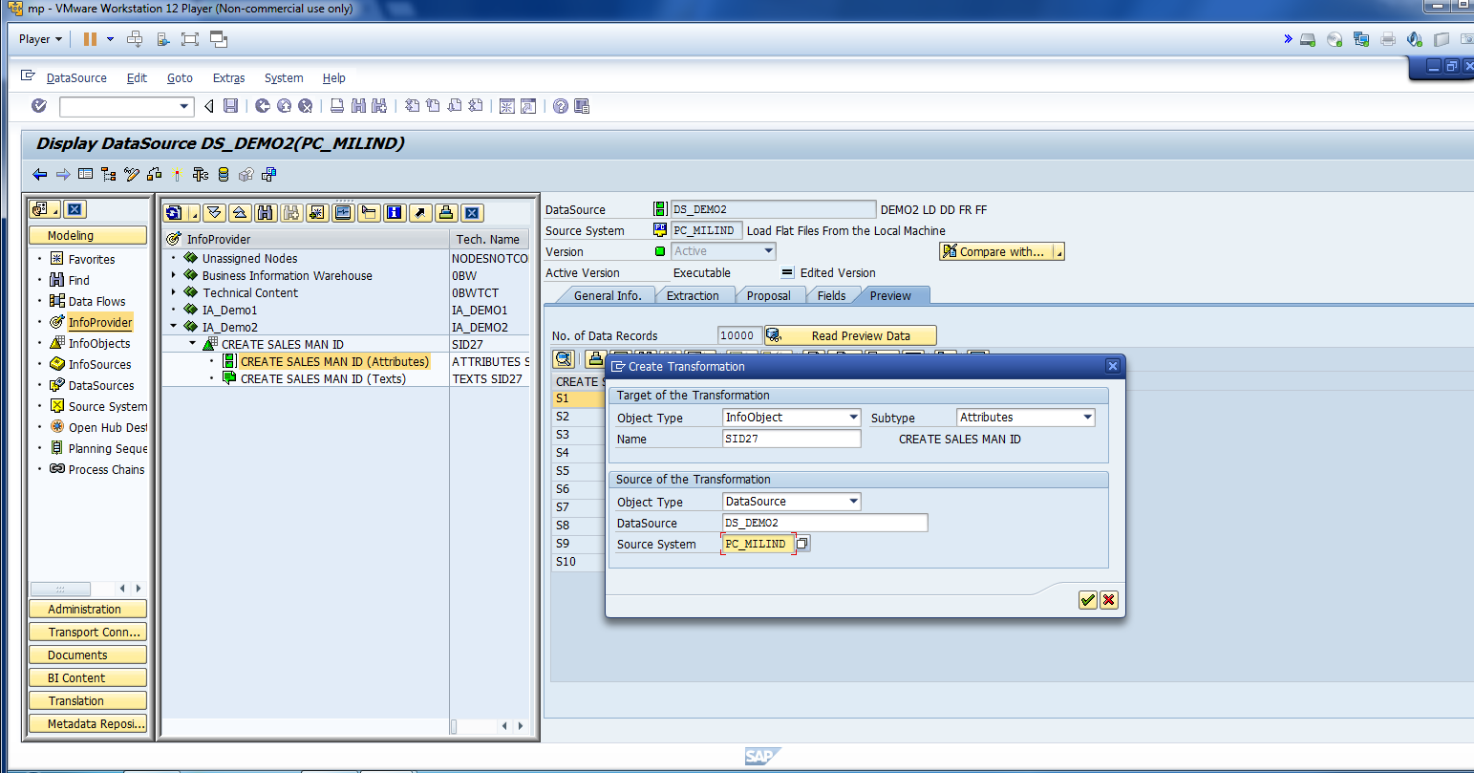
Enter The Information for Transformation.

Slide 28
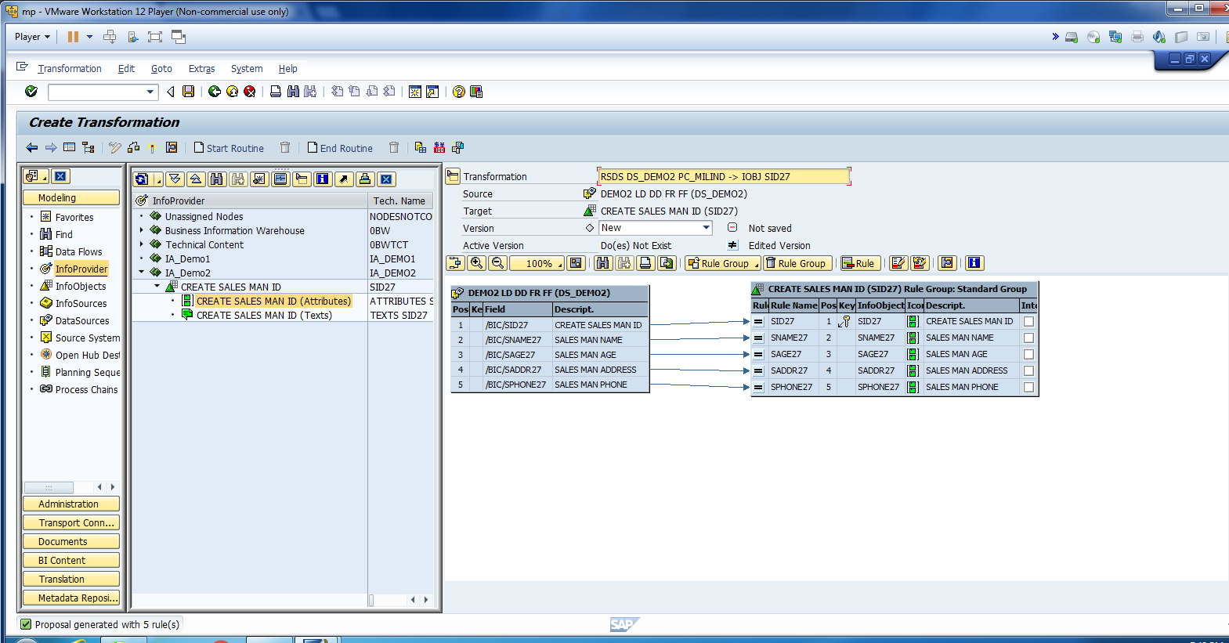
As we already mapped the field you should see all fields has been mapped

Slide 29
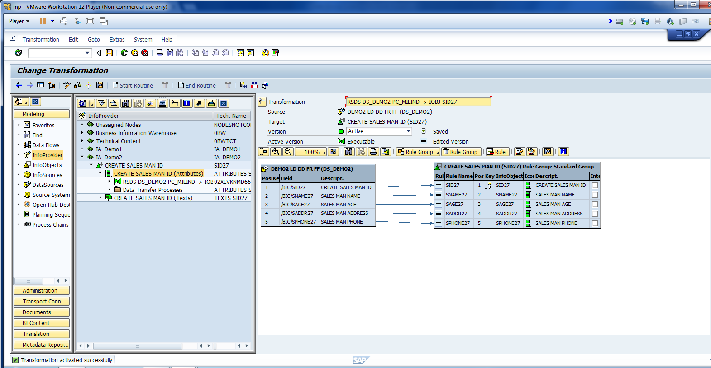
Activate Transformation.

Slide 30
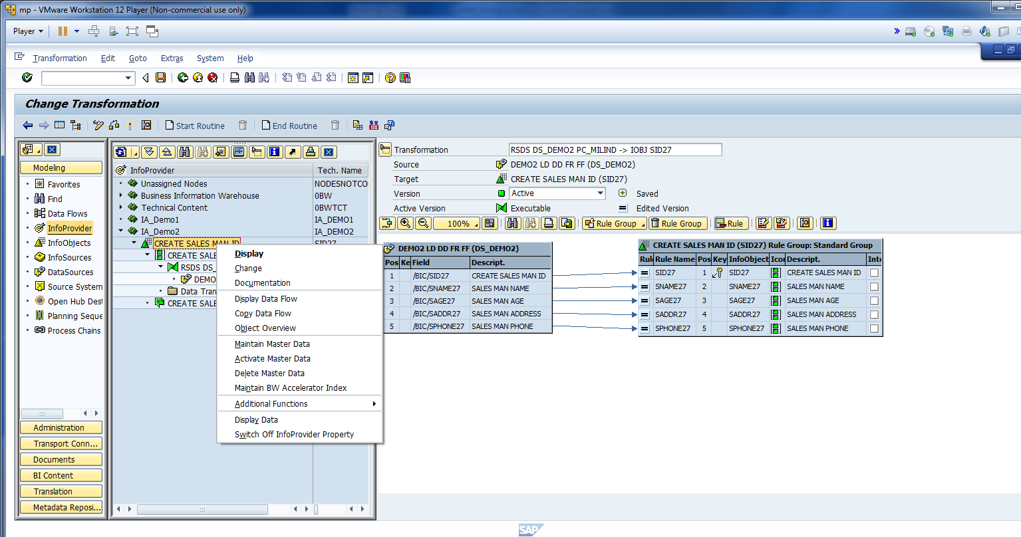
You can click on display data flow.

Slide 31
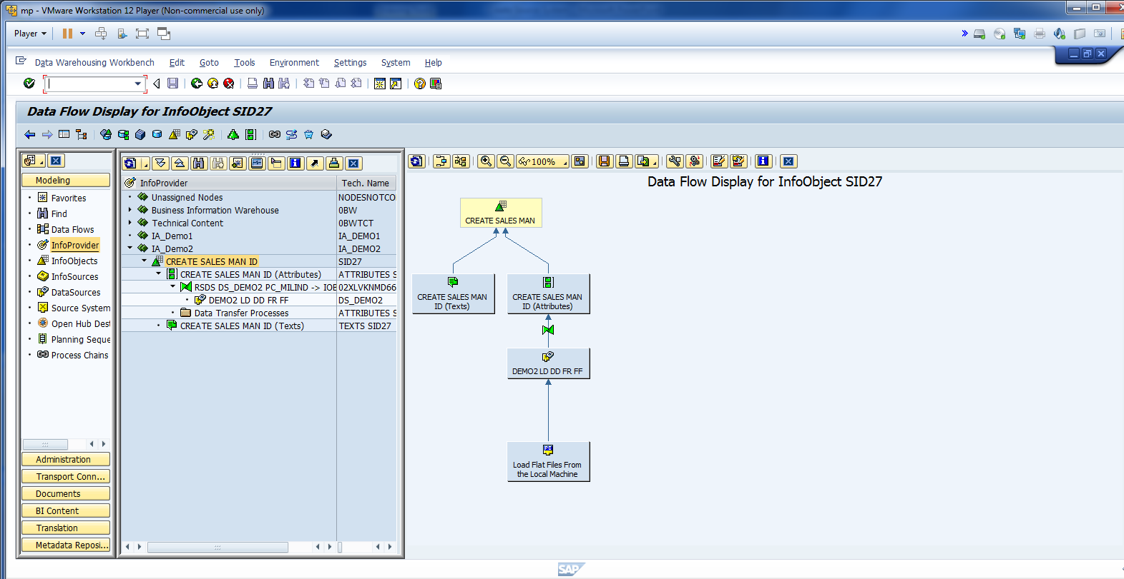
You can see the data flow

Slide 32
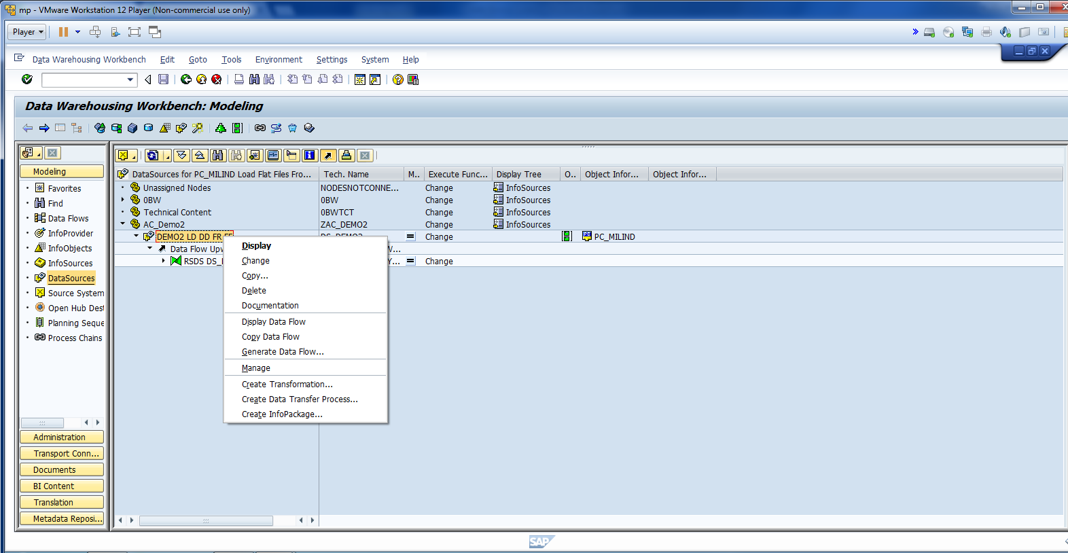
Refresh. Click on data source and create info package.

Slide 33
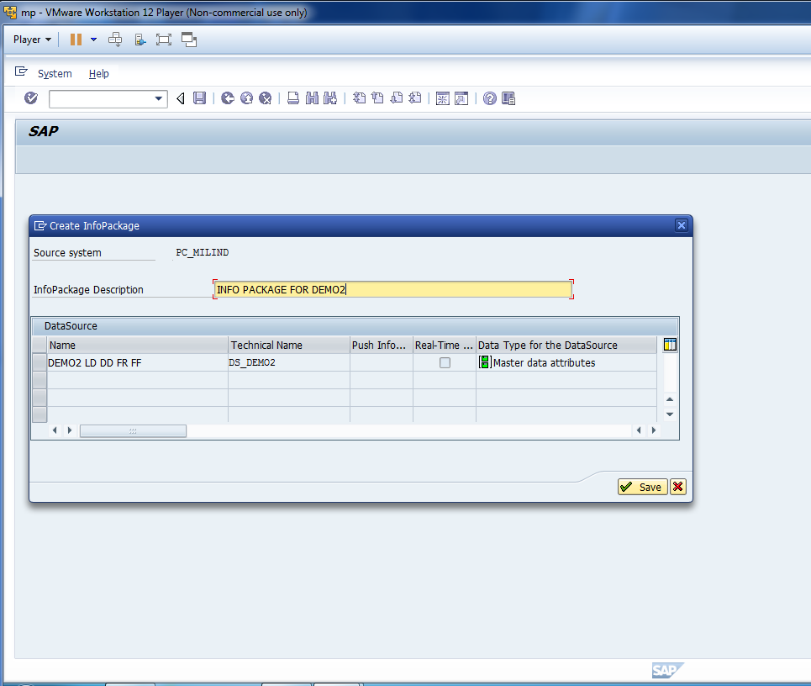
Enter desc and save.

Slide 34
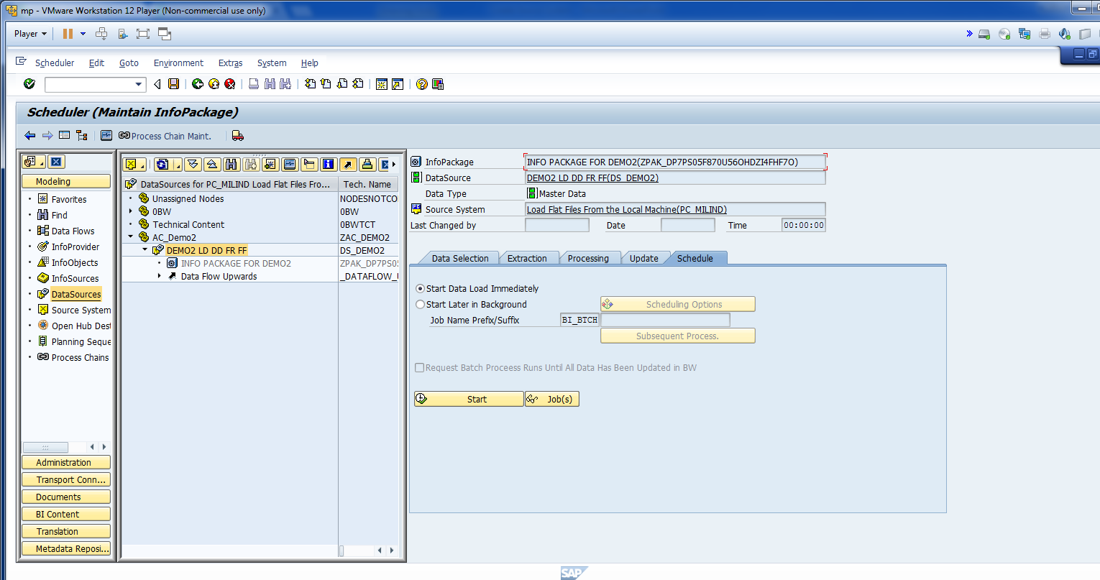
For training purpose, start data loading immediately.

Slide 35
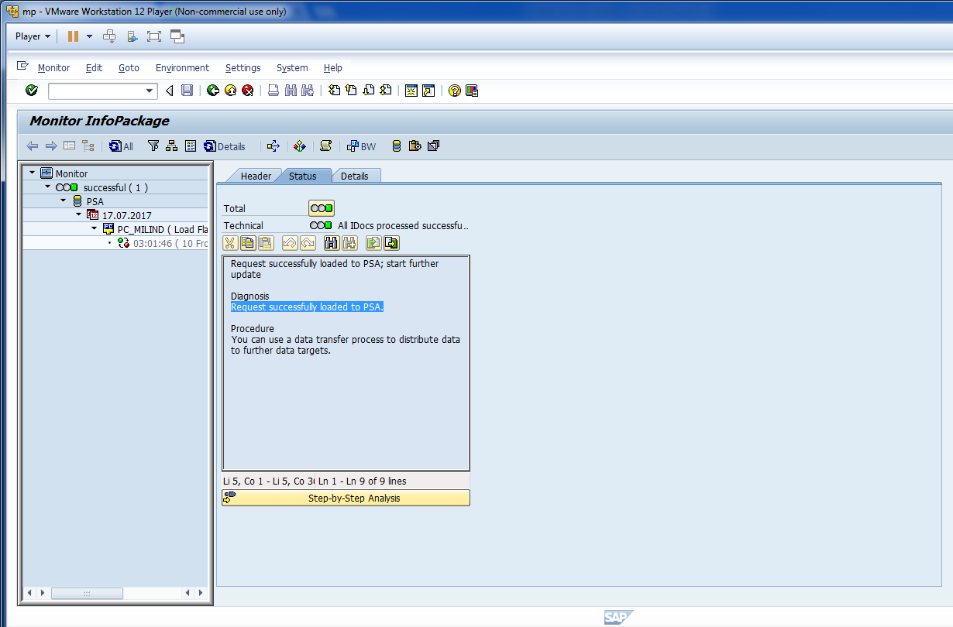
Click on monitor to check the status of the data.

Slide 36
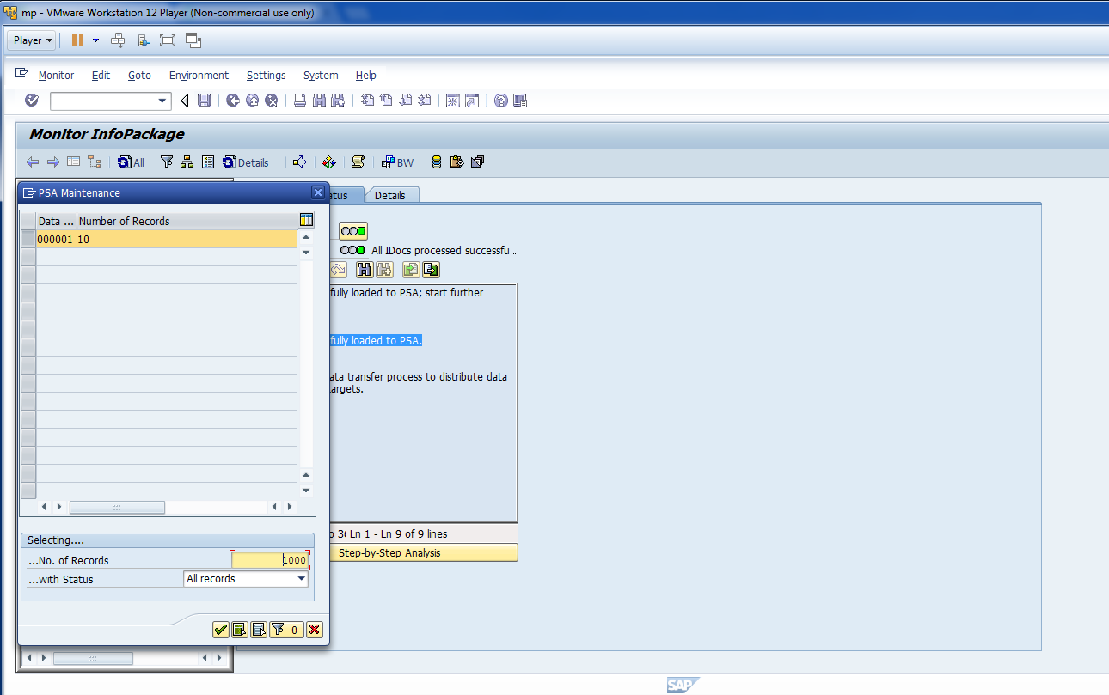
Click on PSA Maintenance.

Slide 37
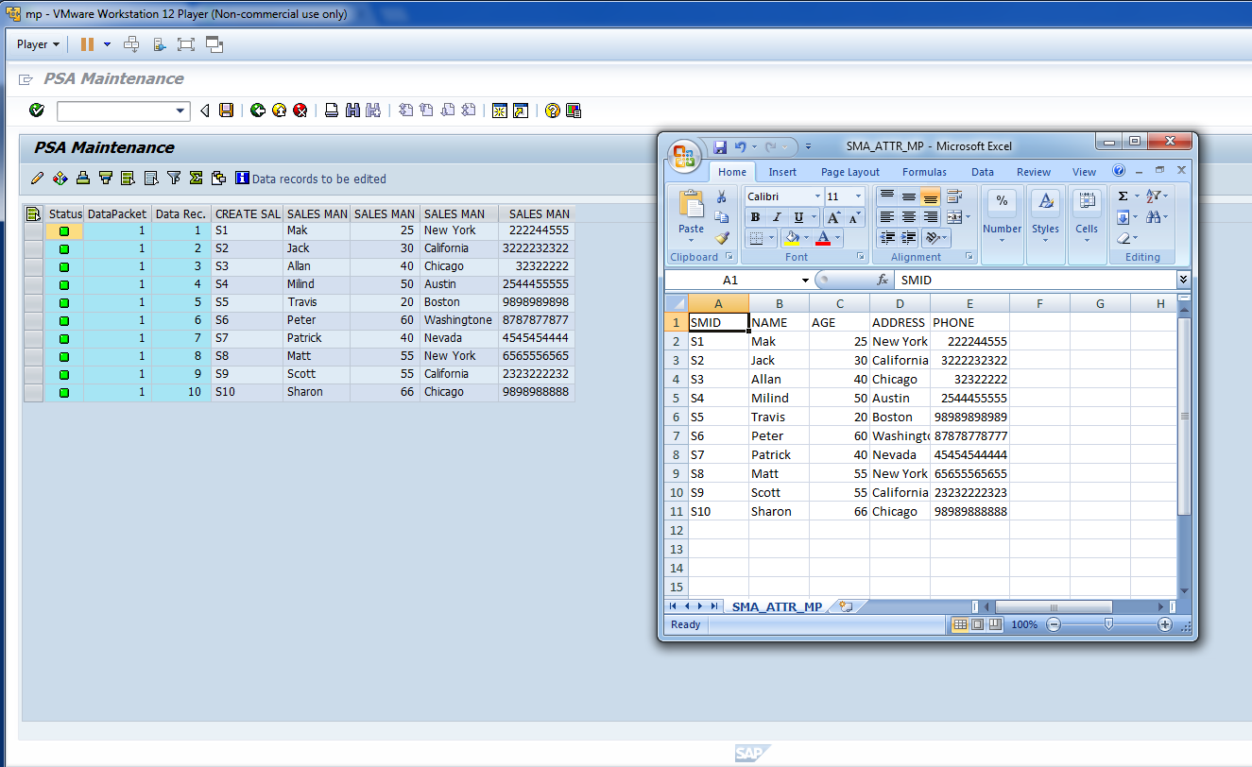
Check the same data has been loaded to PSA.

Slide 38
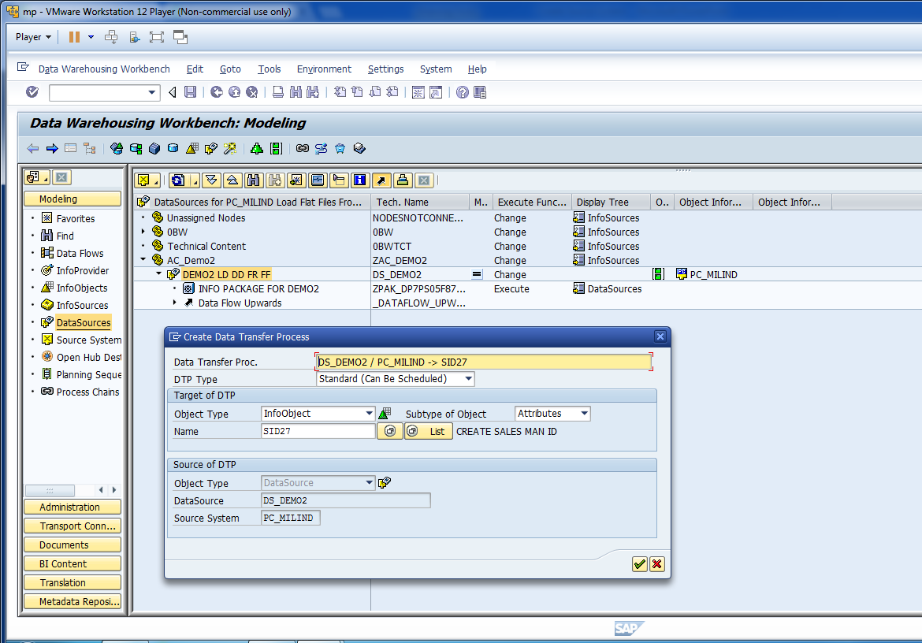
Now, Create Data Transfer Process.

Slide 39
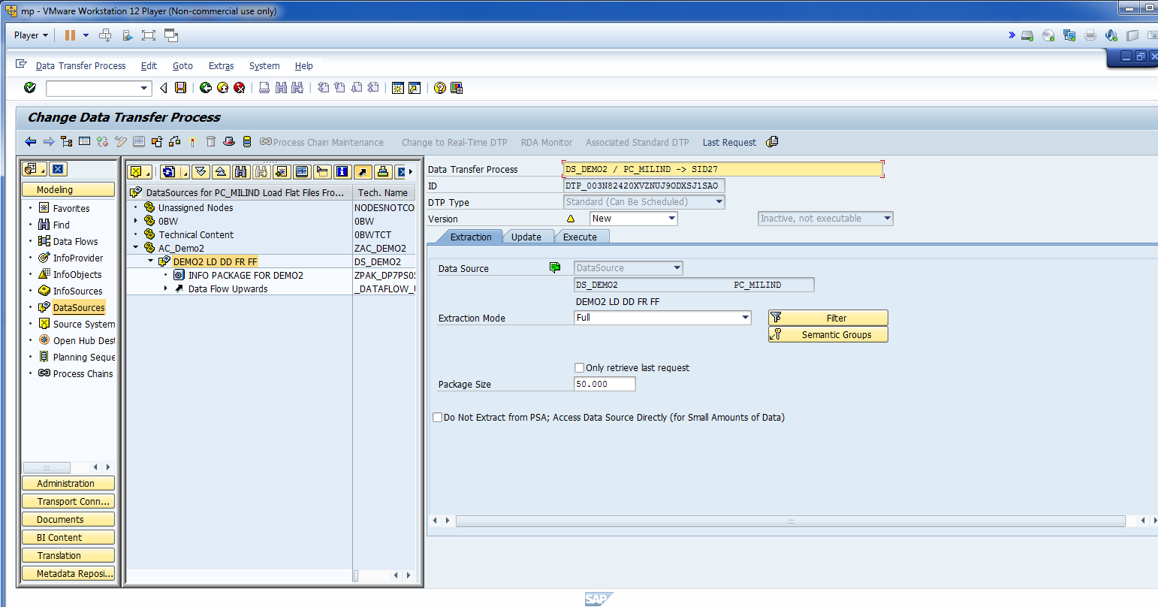
Select Extraction Mode to Full.

Slide 40
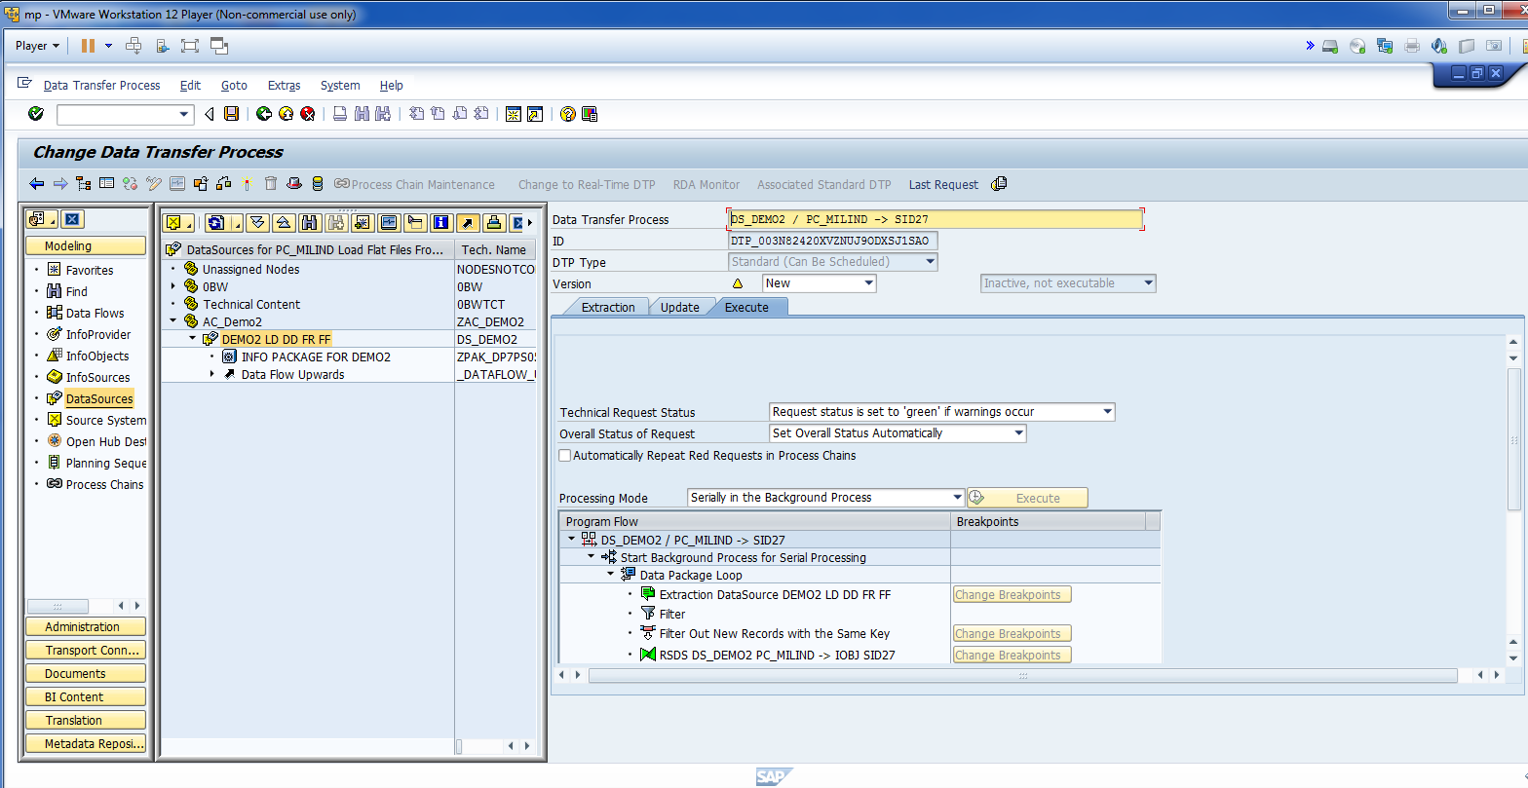
Activate DTP.

Slide 41
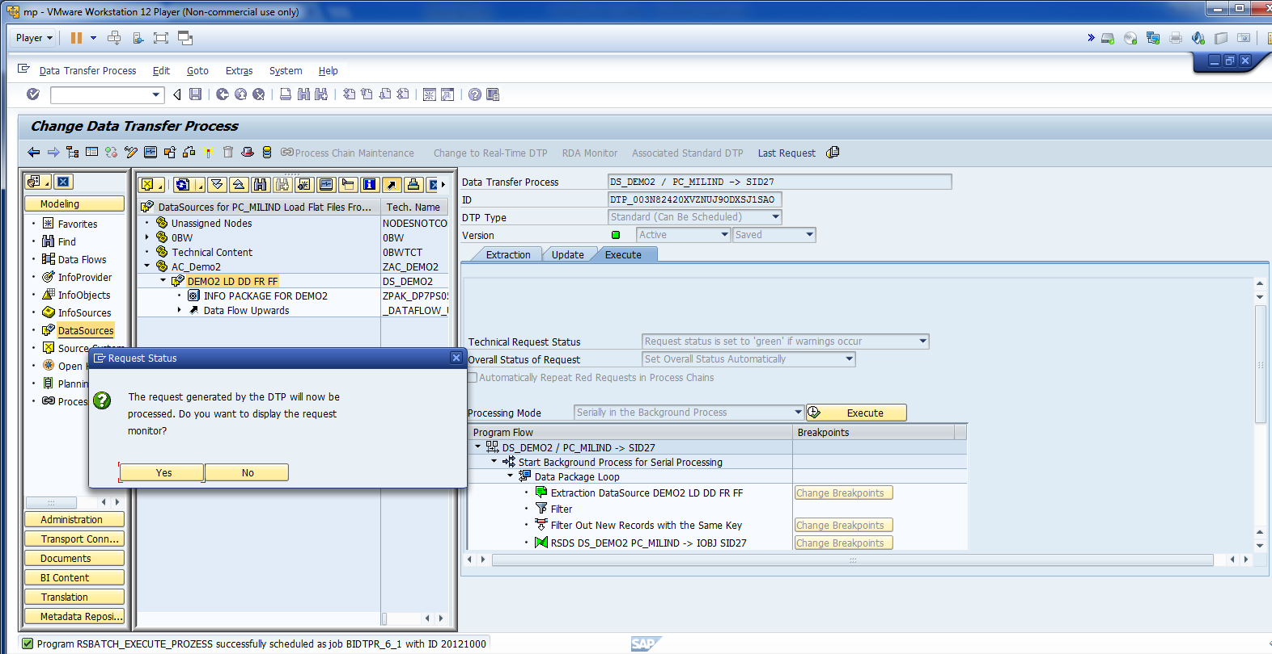
Click Execute and Click Yes.

Slide 42
Load master data with text
Milind Parab

Slide 43
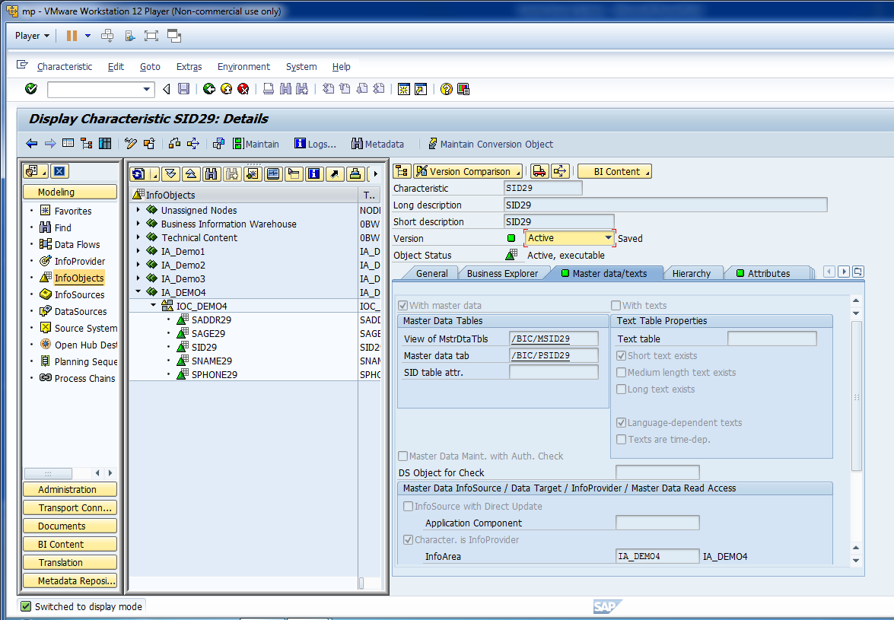
Click change and enable with text option.

Slide 44
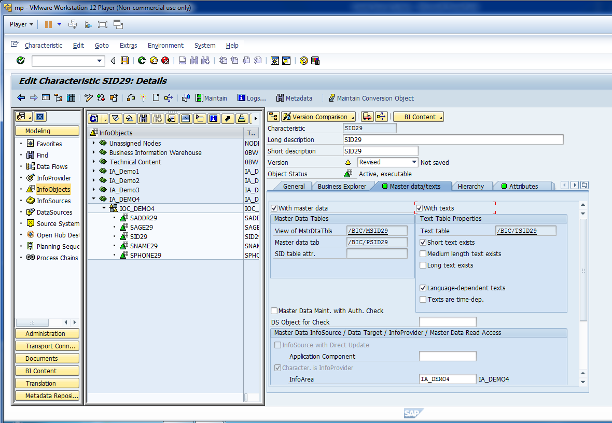
You can enable Medium and Long Text.

Slide 45
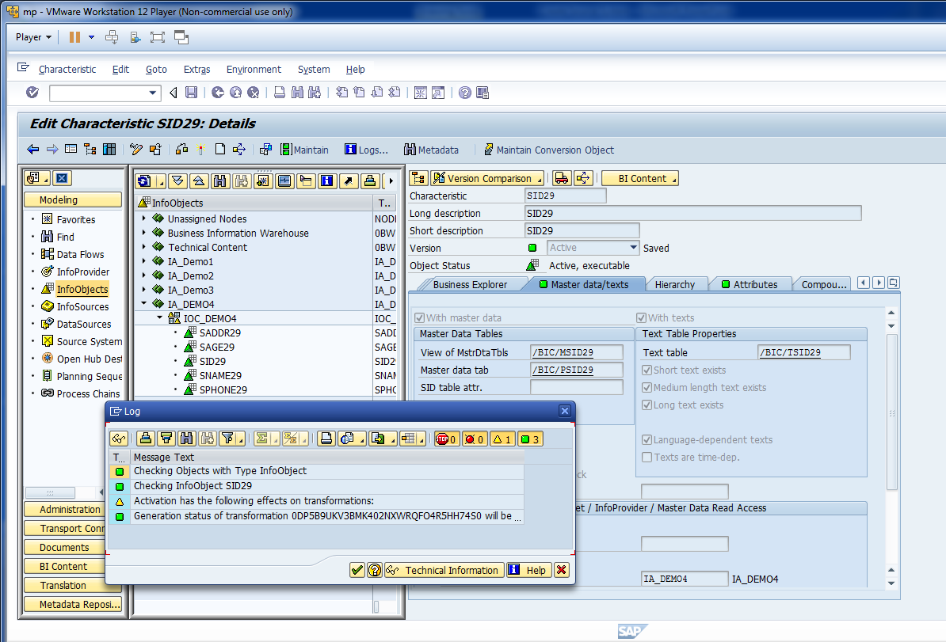
Activate Info Object.

Slide 46
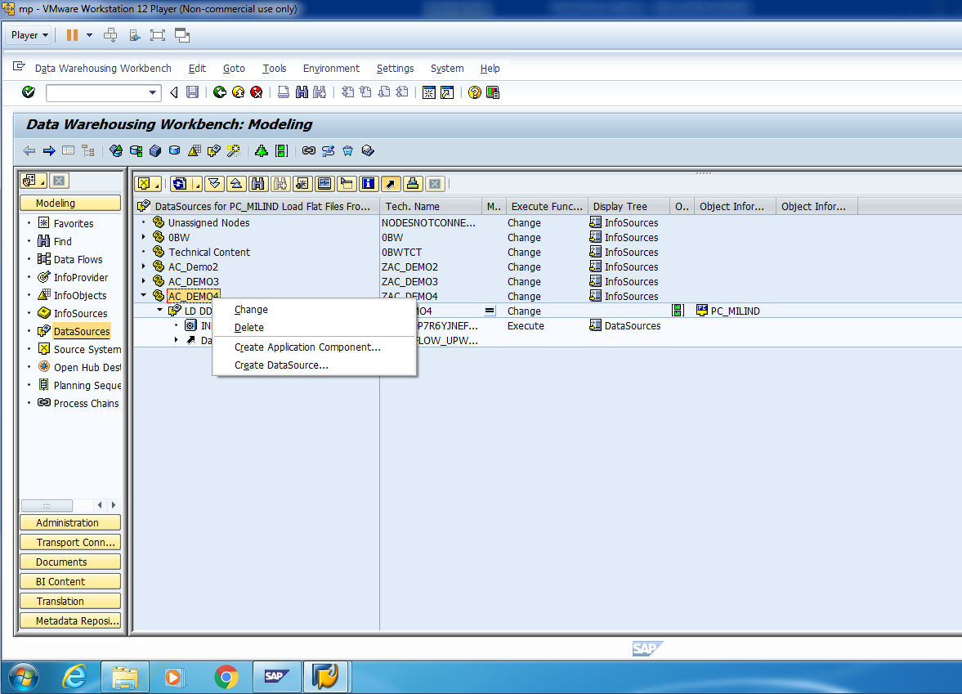
Create Data Source for Text.

Slide 47
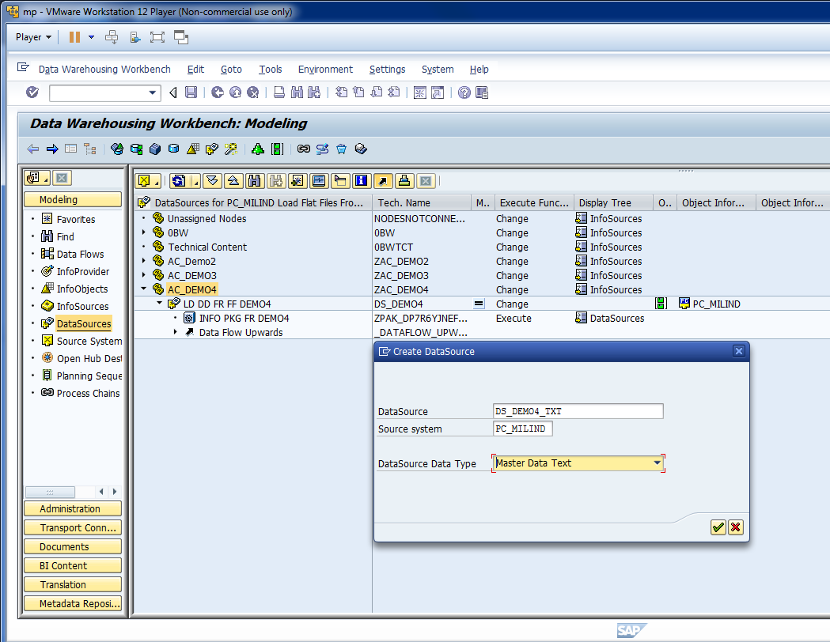
Data Source Data Type: Master Data Text.

Slide 48
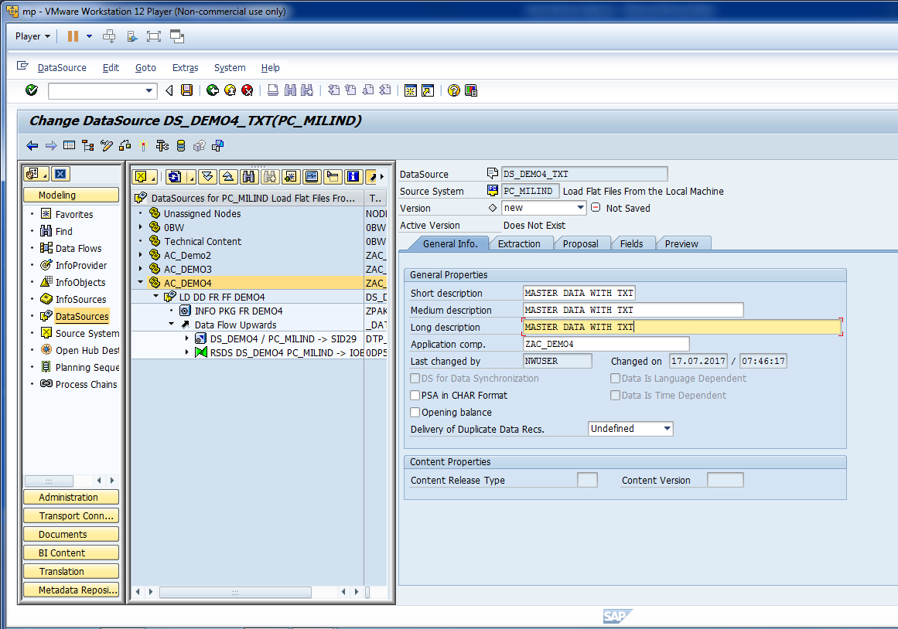
Enter General Info.

Slide 49
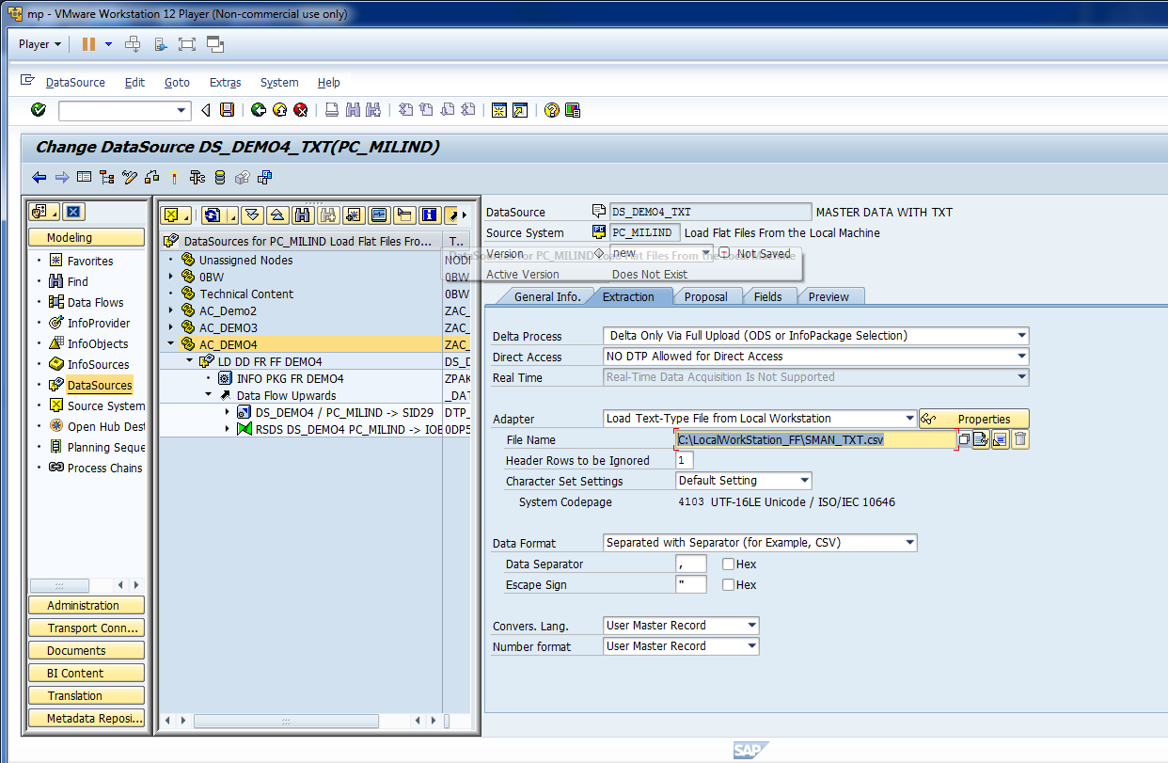
Enter Txt file path.

Slide 50
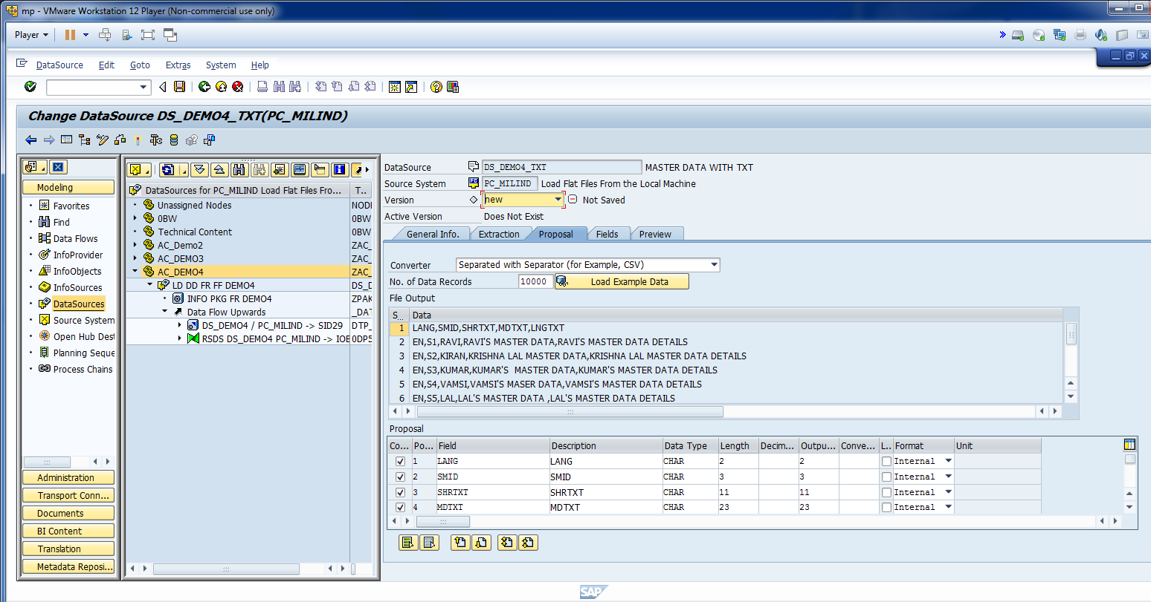
Check Proposal.

Slide 51
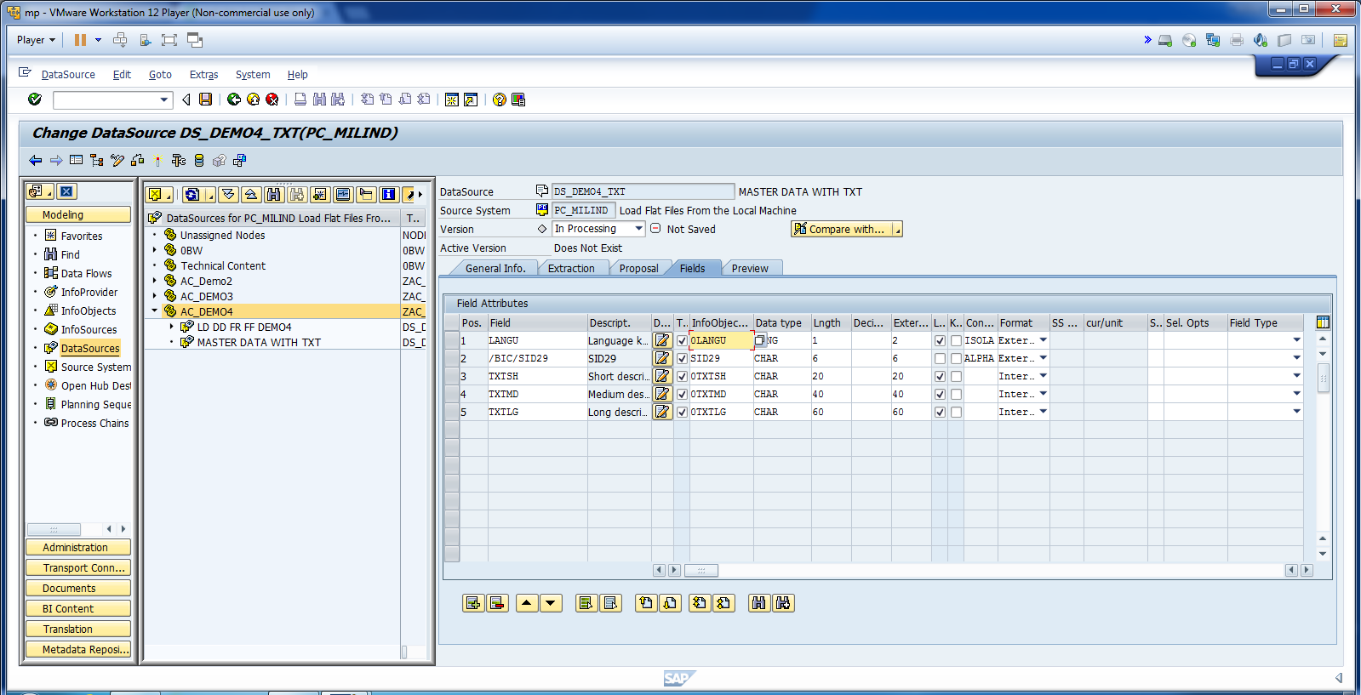
Map Fields.

Slide 52
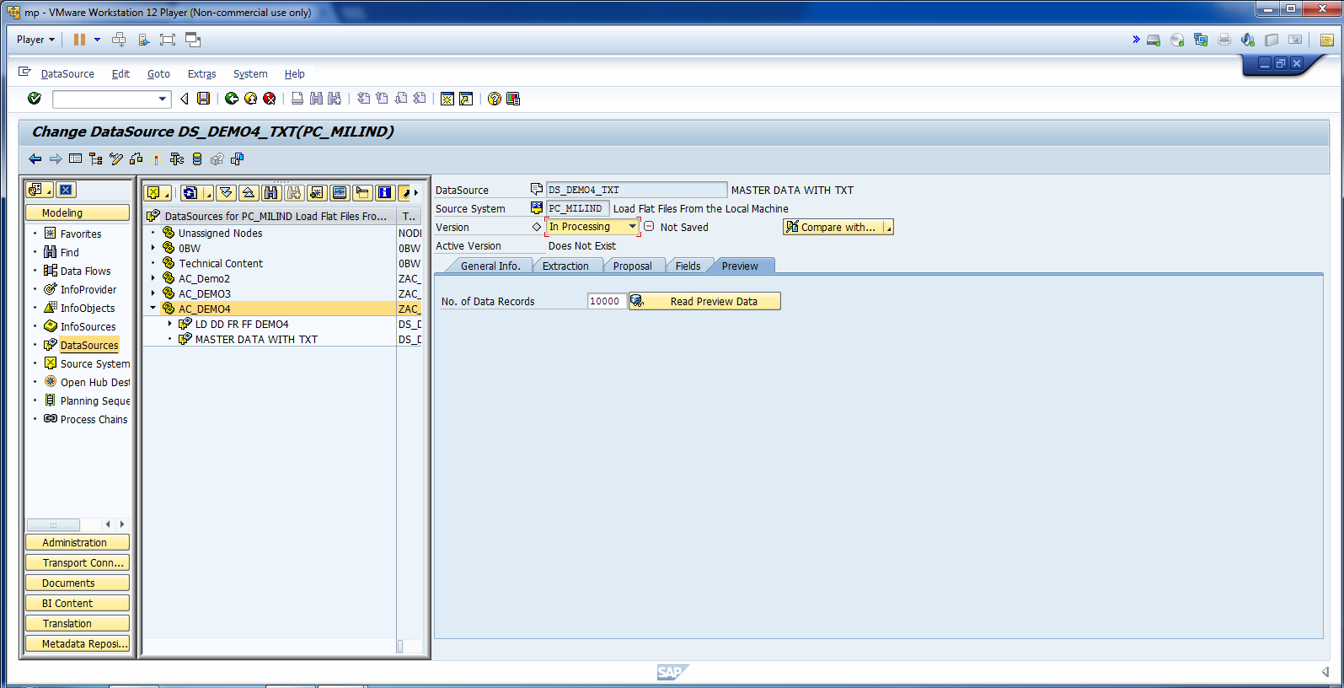
Activate Data Source.

Slide 53

Read Data Preview.

Slide 54

Create Transformation.

Slide 55

Make sure that mapping is okay

Slide 56

Activate Transformation.

Slide 57

Create Info-Package.

Slide 58

Cont.

Slide 59

Start Data Loading in PSA.

Slide 60

Monitor Data in PSA.

Slide 61

Cont.

Slide 62

Create Data Transfer Process.

Slide 63

Cont.

Slide 64

Change Extraction Mode to Full.

Slide 65

Activate DTP.

Slide 66

Click Execute to Initiate DTP.

Slide 67

Monitor DTP.

Slide 68

Click Administrator Data Target.

Slide 69

Data Successfully loaded in BW.

